Slide 1
SU-19-01_LK-79-13 Siquijor, Siquijor

Slide 2
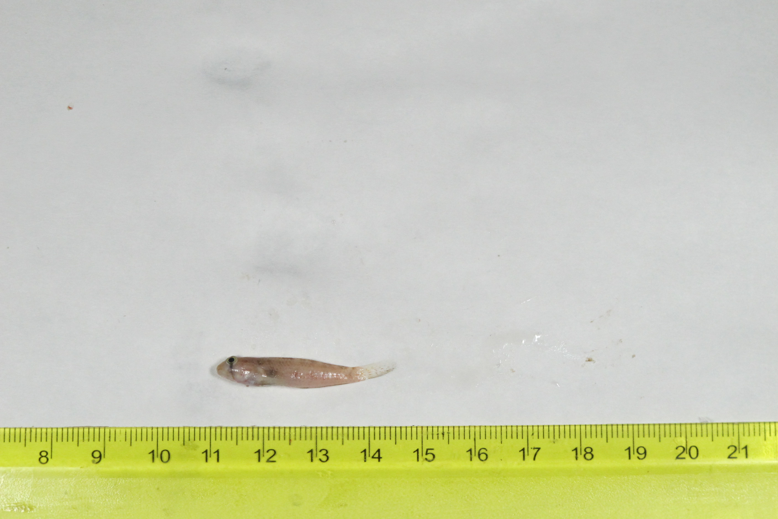
SU-19-01_039 (SUML-039) Original ID: Gnatholepis aujerensis (?) Jeff’s ID:

Slide 3
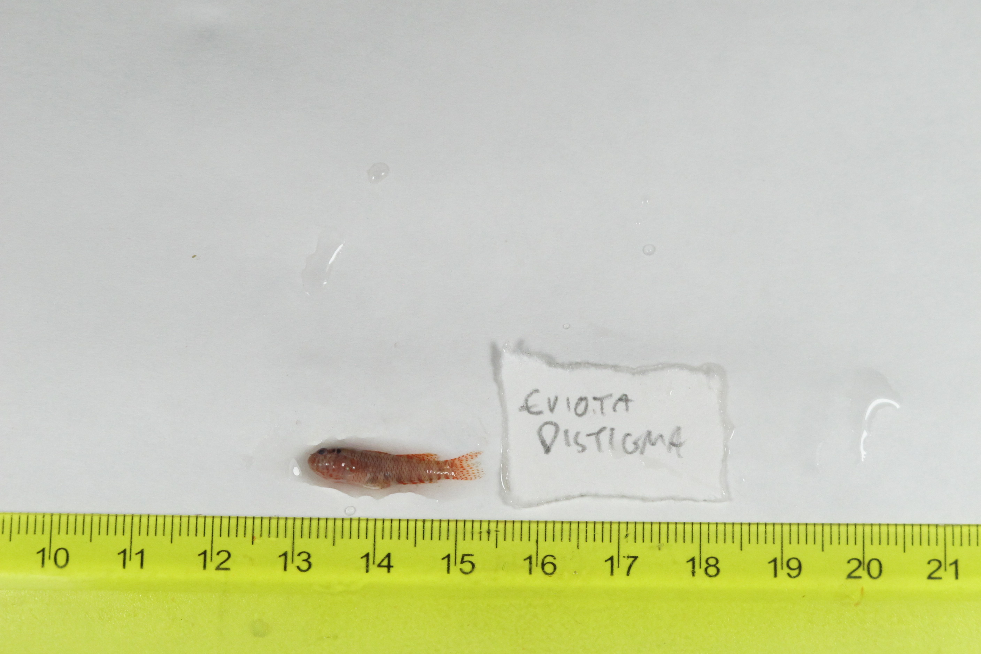
SU-19-01_042 (SUML-042) Original ID: Eviota distigmata → Eviota sparsa (?) Jeff’s ID:

Slide 4
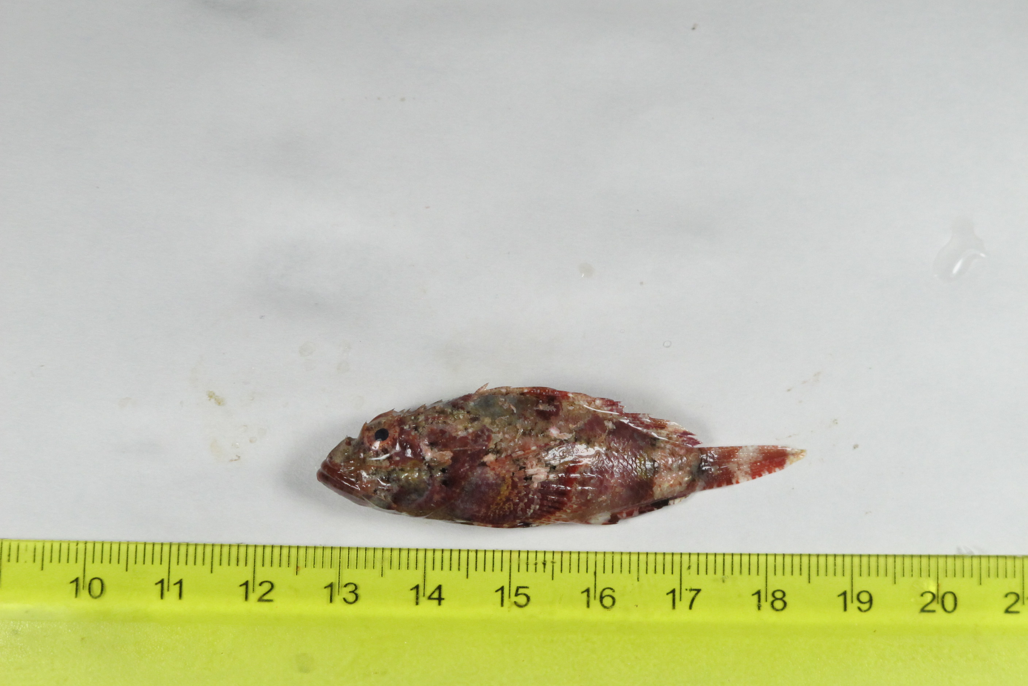
SU-19-01_043 (SUML-043) Original ID: Scorpaenopsis possi (?) Jeff’s ID:

Slide 5
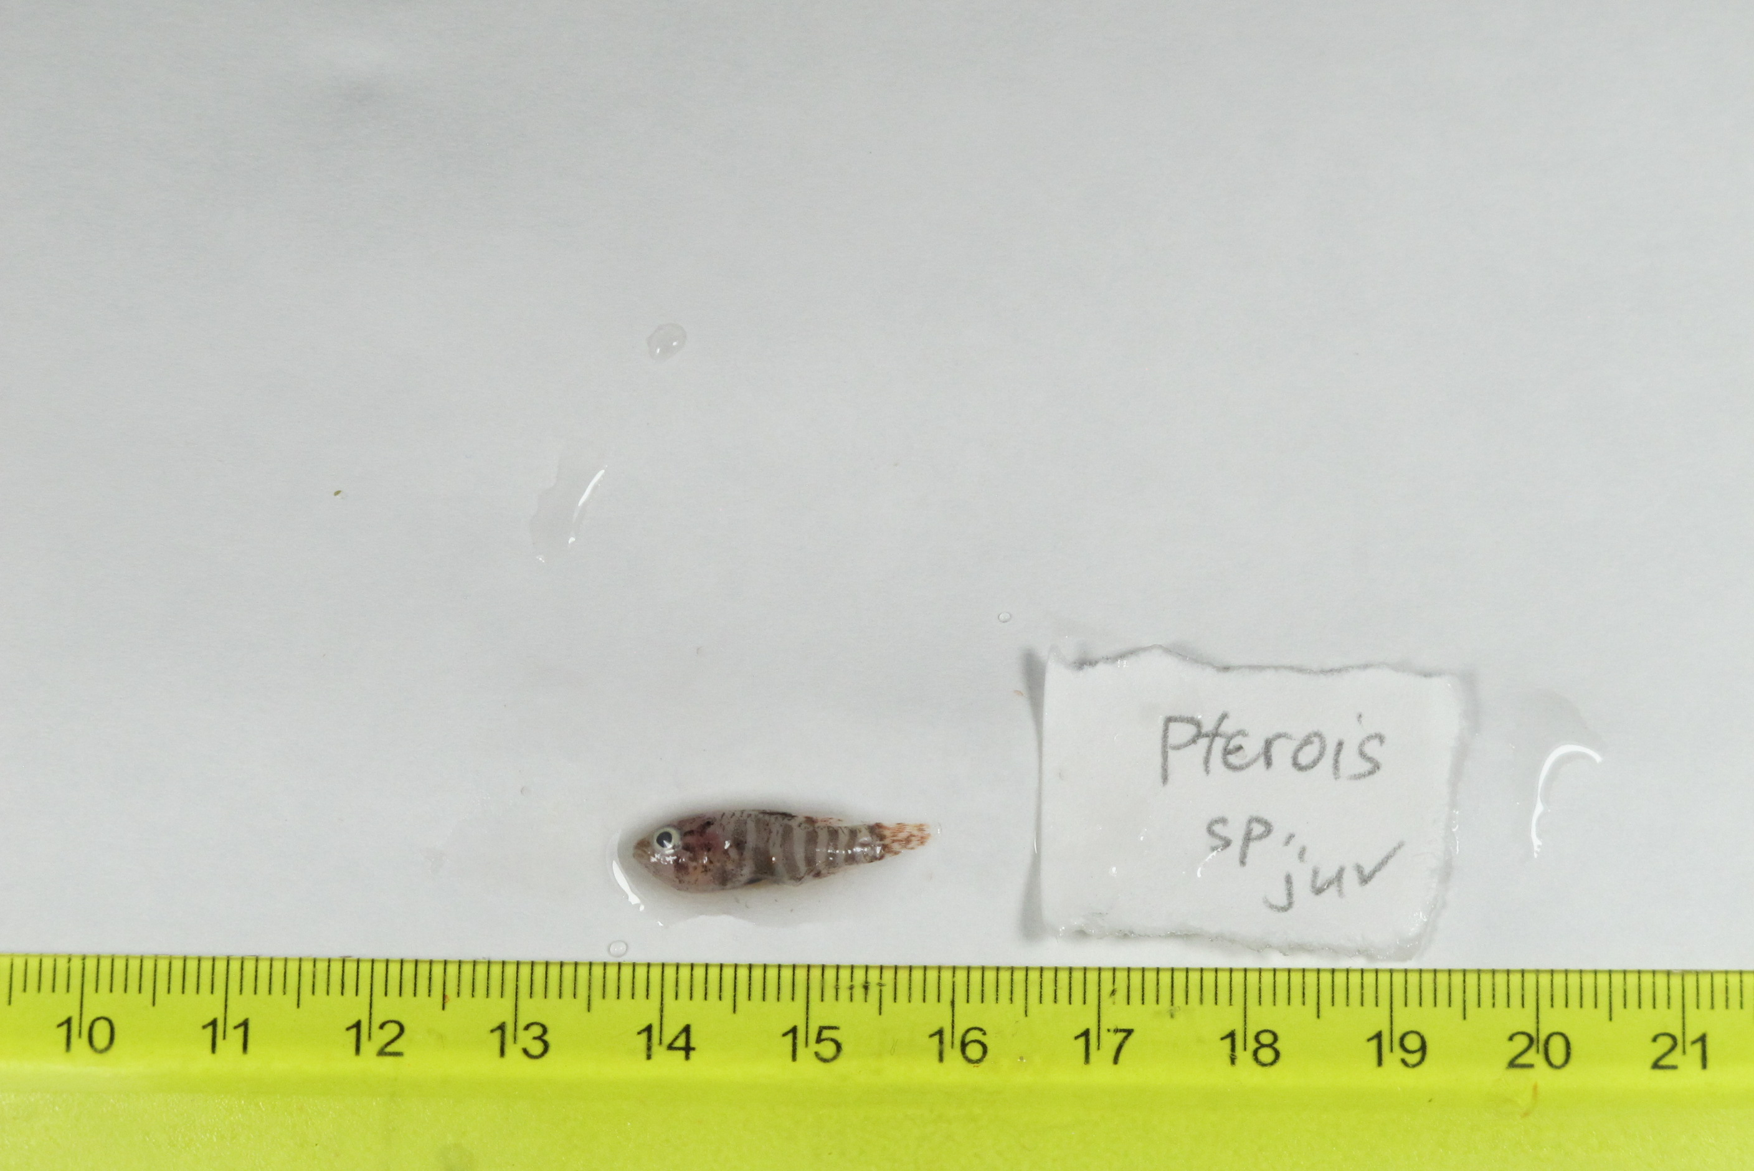
SU-19-01_049 (SUML-049) Original ID: Pterois sp. (juvenile) Jeff’s ID:

Slide 6
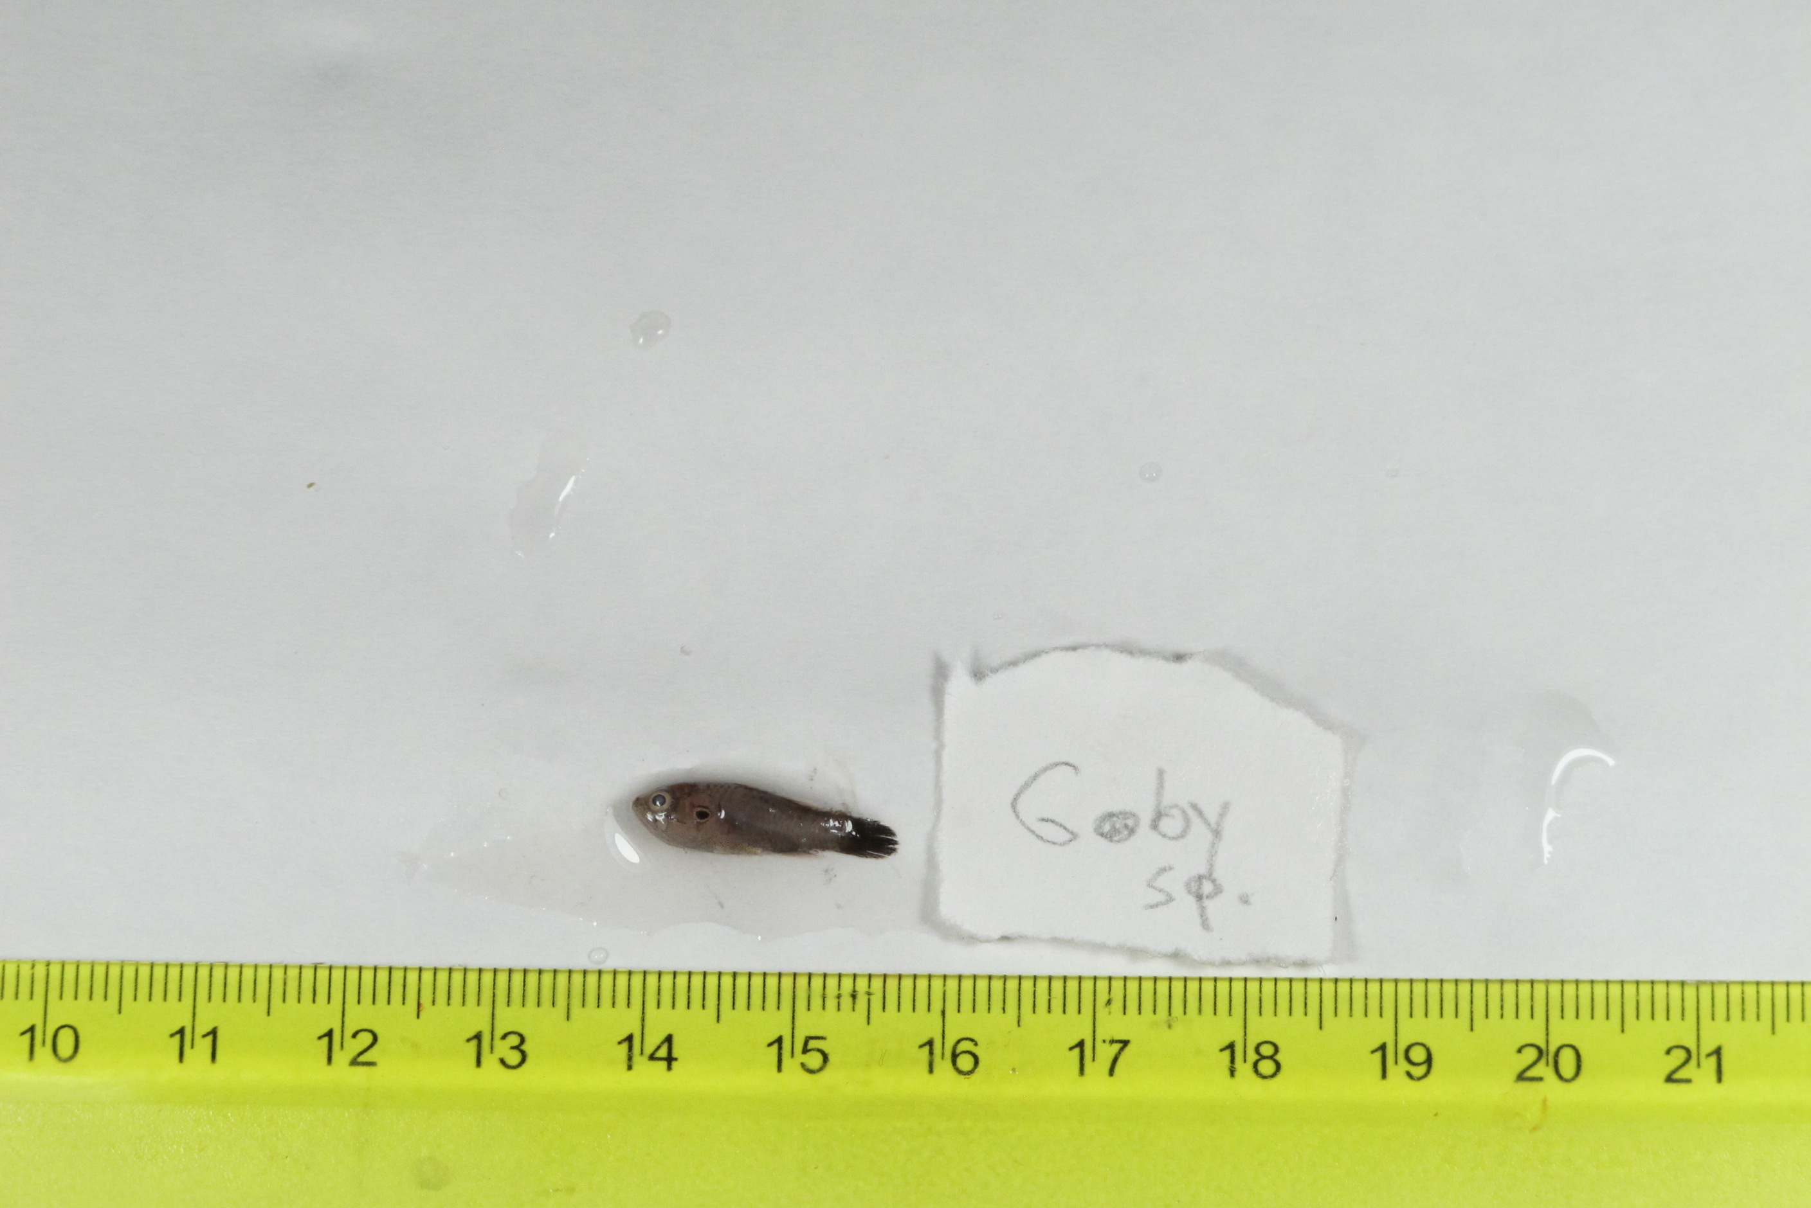
SU-19-01_050 (SUML-050) Original ID: Goby sp. → Eviota distigma (?) Jeff’s ID:

Slide 7
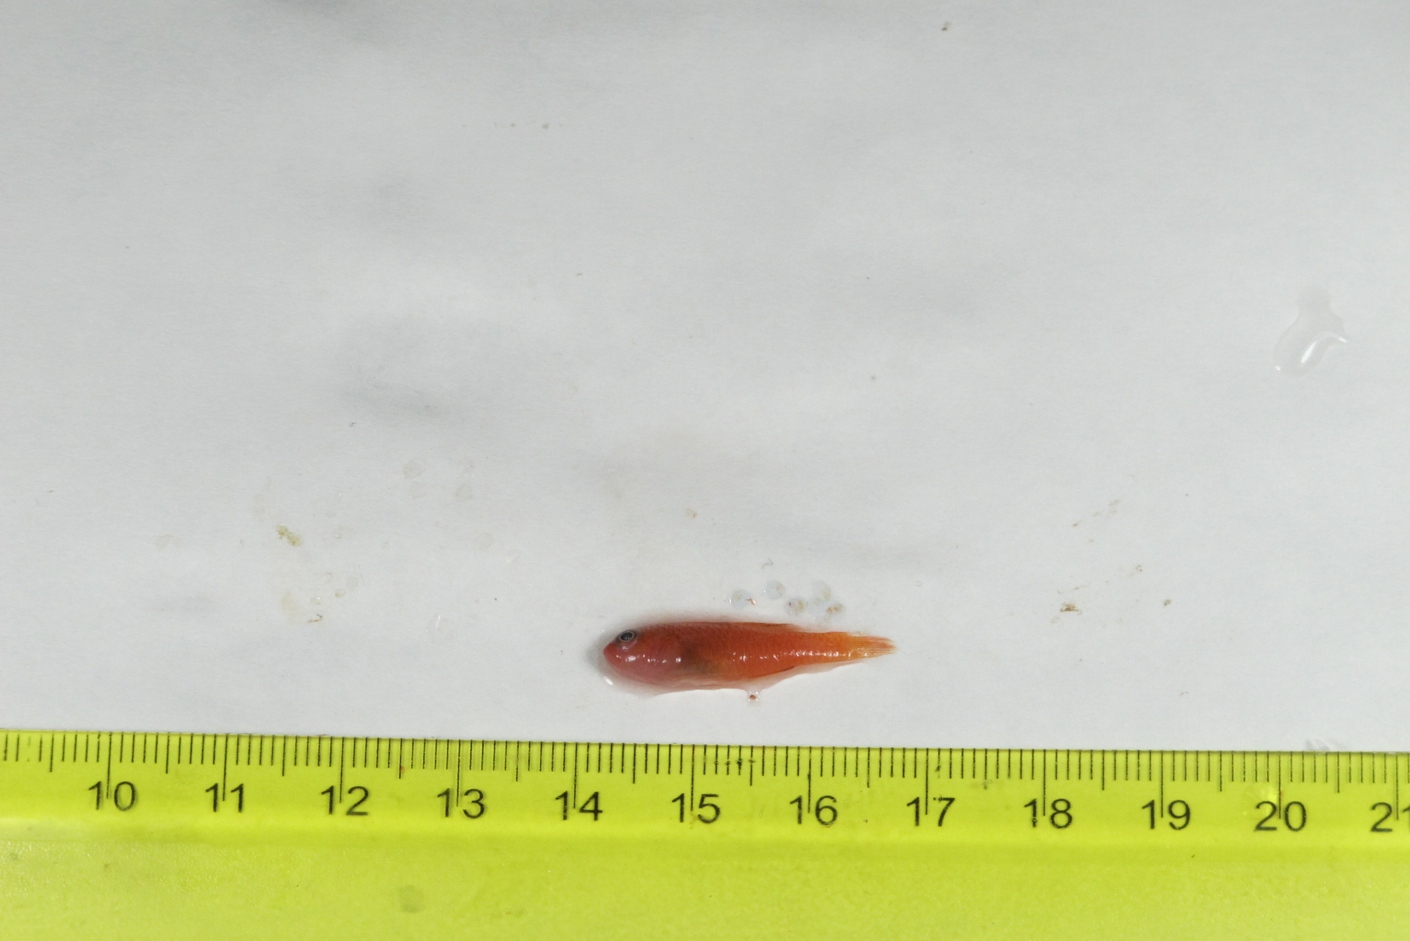
SU-19-01_051 (SUML-051) Original ID: Goby sp. Jeff’s ID:

